Slide 1
CHAPTER 8
Subprograms

Slide 2
CHAPTER 9 TOPICS
Introduction
Fundamentals of Subprograms
Design Issues for Subprograms
Local Referencing Environments
Parameter-Passing Methods
Parameters That Are Subprogram Names
Overloaded Subprograms
Generic Subprograms
Design Issues for Functions
User-Defined Overloaded Operators
Coroutines
1-<number>

Slide 3
INTRODUCTION
Two fundamental abstraction facilities
  Process abstraction
    Emphasized from early days
  Data abstraction
    Emphasized in the1980s
1-<number>

Slide 4
FUNDAMENTALS OF SUBPROGRAMS
Each subprogram has a single entry point
The calling program is suspended during execution of the called subprogram
Control always returns to the caller when the called subprogram’s execution terminates
1-<number>

Slide 5
BASIC DEFINITIONS
A subprogram definition describes the interface to and the actions of the subprogram abstraction
A subprogram call is an explicit request that the subprogram be executed
A subprogram header is the first part of the definition, including the name, the kind of subprogram, and the formal parameters
The parameter profile (aka signature) of a subprogram is the number, order, and types of its parameters
The protocol is a subprogram’s parameter profile and, if it is a function, its return type
1-<number>

Slide 6
BASIC DEFINITIONS (CONTINUED)
Function declarations in C and C++ are often called prototypes
A subprogram declaration provides the protocol, but not the body, of the subprogram
A formal parameter is a dummy variable listed in the subprogram header and used in the subprogram
An actual parameter represents a value or address used in the subprogram call statement
1-<number>

Slide 7
ACTUAL/FORMAL PARAMETER CORRESPONDENCE
Positional
  The binding of actual parameters to formal parameters is by position: the first actual parameter is bound to the first formal parameter and so forth
  Safe and effective
Keyword
  The name of the formal parameter to which an actual parameter is to be bound is specified with the actual parameter
  Parameters can appear in any order
1-<number>

Slide 8
FORMAL PARAMETER DEFAULT VALUES
In certain languages (e.g., C++, Ada), formal parameters can have default values (if not actual parameter is passed)
  In C++, default parameters must appear last because parameters are positionally associated
C# methods can accept a variable number of parameters as long as they are of the same type
1-<number>

Slide 9
PROCEDURES AND FUNCTIONS
There are two categories of subprograms
  Procedures are collection of statements that define parameterized computations
  Functions structurally resemble procedures but are semantically modeled on mathematical functions
    They are expected to produce no side effects
    In practice, program functions have side effects
1-<number>

Slide 10
DESIGN ISSUES FOR SUBPROGRAMS
What parameter passing methods are provided?
Are parameter types checked?
Are local variables static or dynamic?
Can subprogram definitions appear in other subprogram definitions?
Can subprograms be overloaded?
Can subprogram be generic?
1-<number>

Slide 11
LOCAL REFERENCING ENVIRONMENTS
Local variables can be stack-dynamic (bound to storage)
  Advantages
    Support for recursion
    Storage for locals is shared among some subprograms
  Disadvantages
    Allocation/de-allocation, initialization time
    Indirect addressing
    Subprograms cannot be history sensitive
Local variables can be static
  More efficient (no indirection)
  No run-time overhead
  Cannot support recursion
1-<number>

Slide 12
PARAMETER PASSING METHODS
Ways in which parameters are transmitted to and/or from called subprograms
  Pass-by-value
  Pass-by-result
  Pass-by-value-result
  Pass-by-reference
  Pass-by-name
1-<number>

Slide 13
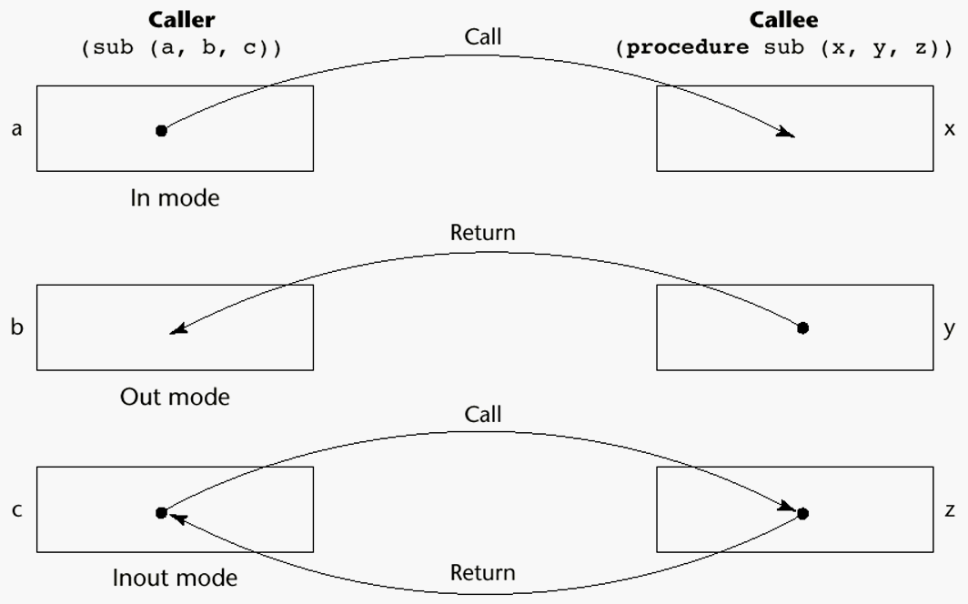
MODELS OF PARAMETER PASSING
1-<number>

Slide 14
PASS-BY-VALUE (IN MODE)
The value of the actual parameter is used to initialize the corresponding formal parameter
  Normally implemented by copying
  Can be implemented by transmitting an access path but not recommended (enforcing write protection is not easy)
  When copies are used, additional storage is required
  Storage and copy operations can be costly (large parameters)
1-<number>

Slide 15
PASS-BY-RESULT (OUT MODE)
When a parameter is passed by result, no value is transmitted to the subprogram; the corresponding formal parameter acts as a local variable; its value is transmitted to caller’s actual parameter when control is returned to the caller
  Require extra storage location and copy operation
Potential problem: sub(p1, p1); whichever formal parameter is copied back will represent the current value of p1
1-<number>

Slide 16
PASS-BY-VALUE-RESULT (INOUT MODE)
A combination of pass-by-value and pass-by-result
Sometimes called pass-by-copy
Formal parameters have local storage
Disadvantages:
  Those of pass-by-result
  Those of pass-by-value
1-<number>

Slide 17
PASS-BY-REFERENCE (INOUT MODE)
Pass an access path
Also called pass-by-sharing
Passing process is efficient (no copying and no duplicated storage)
Disadvantages
  Slower accesses (compared to pass-by-value) to formal parameters
  Potentials for un-wanted side effects
  Un-wanted aliases (access broadened)
1-<number>

Slide 18
PASS-BY-NAME (INOUT MODE)
By textual substitution
Formals are bound to an access method at the time of the call, but actual binding to a value or address takes place at the time of a reference or assignment
Allows flexibility in late binding
1-<number>

Slide 19
EXERCISE
Consider the following program written in C syntax:
void fun (int first, int second)
{
first += first;
second += second;
}
void main()
{
int list[2] = {1, 3};
fun(list[0], list[1]);
}
For each of the following parameter-passing methods, what are the values
of the list array after execution?
a. Passed by value
b. Passed by reference
c. Passed by value-result
1-<number>

Slide 20
IMPLEMENTING PARAMETER-PASSING METHODS
In most language parameter communication takes place thru the run-time stack
Pass-by-reference are the simplest to implement; only an address is placed in the stack
A subtle but fatal error can occur with pass-by-reference and pass-by-value-result: a formal parameter corresponding to a constant can mistakenly be changed
1-<number>

Slide 21
PARAMETER PASSING METHODS OF MAJOR LANGUAGES
Fortran
  Always used the inout semantics model
  Before Fortran 77: pass-by-reference
  Fortran 77 and later: scalar variables are often passed by value-result
C
  Pass-by-value
  Pass-by-reference is achieved by using pointers as parameters
C++
  A special pointer type called reference type for pass-by-reference
Java
  All parameters are passed are passed by value
  Object parameters are passed by reference
1-<number>

Slide 22
PARAMETER PASSING METHODS OF MAJOR LANGUAGES (CONTINUED)
Ada
  Three semantics modes of parameter transmission: in, out, in out; in is the default mode
  Formal parameters declared out can be assigned but not referenced; those declared in can be referenced but not assigned; in out parameters can be referenced and assigned
C#
  Default method: pass-by-value
  Pass-by-reference is specified by preceding both a formal parameter and its actual parameter with ref
PHP: very similar to C#
Perl: all actual parameters are implicitly placed in a predefined array named @_
1-<number>

Slide 23
TYPE CHECKING PARAMETERS
Considered very important for reliability
FORTRAN 77 and original C: none
Pascal, FORTRAN 90, Java, and Ada: it is always required
ANSI C and C++: choice is made by the user
  Prototypes
Relatively new languages Perl, JavaScript, and PHP do not require type checking
1-<number>

Slide 24
MULTIDIMENSIONAL ARRAYS AS PARAMETERS
If a multidimensional array is passed to a subprogram and the subprogram is separately compiled, the compiler needs to know the declared size of that array to build the storage mapping function
1-<number>

Slide 25
MULTIDIMENSIONAL ARRAYS AS PARAMETERS: C AND C++
Programmer is required to include the declared sizes of all but the first subscript in the actual parameter
Disallows writing flexible subprograms
Solution: pass a pointer to the array and the sizes of the dimensions as other parameters; the user must include the storage mapping function in terms of the size parameters
1-<number>

Slide 26
MULTIDIMENSIONAL ARRAYS AS PARAMETERS: PASCAL AND ADA
Pascal
  Not a problem; declared size is part of the array’s type
Ada
  Constrained arrays - like Pascal
  Unconstrained arrays - declared size is part of the object declaration
1-<number>

Slide 27
MULTIDIMENSIONAL ARRAYS AS PARAMETERS: FORTRAN
Formal parameter that are arrays have a declaration after the header
  For single-dimension arrays, the subscript is irrelevant
  For multi-dimensional arrays, the subscripts allow the storage-mapping function
1-<number>

Slide 28
MULTIDIMENSIONAL ARRAYS AS PARAMETERS: JAVA AND C#
Similar to Ada
Arrays are objects; they are all single-dimensioned, but the elements can be arrays
Each array inherits a named constant (length in Java, Length in C#) that is set to the length of the array when the array object is created
1-<number>

Slide 29
DESIGN CONSIDERATIONS FOR PARAMETER PASSING
Two important considerations
  Efficiency
  One-way or two-way data transfer
But the above considerations are in conflict
  Good programming suggest limited access to variables, which means one-way whenever possible
  But pass-by-reference is more efficient to pass structures of significant size
1-<number>

Slide 30
PARAMETERS THAT ARE SUBPROGRAM NAMES
It is sometimes convenient to pass subprogram names as parameters
Issues:
  Are parameter types checked?
  What is the correct referencing environment for a subprogram that was sent as a parameter?
1-<number>

Slide 31
PARAMETERS THAT ARE SUBPROGRAM NAMES: PARAMETER TYPE CHECKING
C and C++: functions cannot be passed as parameters but pointers to functions can be passed; parameters can be type checked
FORTRAN 95 type checks
Later versions of Pascal and
Ada does not allow subprogram parameters; a similar alternative is provided via Ada’s generic facility
1-<number>

Slide 32
PARAMETERS THAT ARE SUBPROGRAM NAMES: REFERENCING ENVIRONMENT
Shallow binding: The environment of the call statement that enacts the passed subprogram
Deep binding: The environment of the definition of the passed subprogram
Ad hoc binding: The environment of the call statement that passed the subprogram as actual parameter.
1-<number>

Slide 33
PARAMETERS THAT ARE SUBPROGRAM NAMES
function sub1(){ Shallow binding, x = 4
var x;
function sub2(){ Deep binding, x = 1
alert(x);
}; Ad hoc binding, x = 3
function sub3(){
var x=3;
sub4(sub2);
};
function sub4(subx){
var x=4;
subx();
};
x=1;
sub3();
};
1-<number>

Slide 34
OVERLOADED SUBPROGRAMS
An overloaded subprogram is one that has the same name as another subprogram in the same referencing environment
  Every version of an overloaded subprogram has a unique protocol
C++, Java, C#, and Ada include predefined overloaded subprograms
In Ada, the return type of an overloaded function can be used to disambiguate calls (thus two overloaded functions can have the same parameters)
Ada, Java, C++, and C# allow users to write multiple versions of subprograms with the same name
1-<number>

Slide 35
GENERIC SUBPROGRAMS
A generic or polymorphic subprogram takes parameters of different types on different activations
Overloaded subprograms provide ad hoc polymorphism
A subprogram that takes a generic parameter that is used in a type expression that describes the type of the parameters of the subprogram provides parametric polymorphism
1-<number>

Slide 36
EXAMPLES OF PARAMETRIC POLYMORPHISM: C++
template <class Type>
Type max(Type first, Type second) {
return first > second ? first : second;
}
The above template can be instantiated for any type for which operator > is defined
  int max (int first, int second) {
  return first > second? first : second;
  }
1-<number>

Slide 37
DESIGN ISSUES FOR FUNCTIONS
Are side effects allowed?
  Parameters should always be in-mode to reduce side effect (like Ada)
What types of return values are allowed?
  Most imperative languages restrict the return types
  C allows any type except arrays and functions
  C++ is like C but also allows user-defined types
  Ada allows any type
  Java and C# do not have functions but methods can have any type
1-<number>

Slide 38
USER-DEFINED OVERLOADED OPERATORS
Operators can be overloaded in Ada and C++
An Ada example
  Function “*”(A,B: in Vec_Type): return Integer is
  Sum: Integer := 0;
  begin
  for Index in A’range loop
  Sum := Sum + A(Index) * B(Index)
  end loop
  return sum;
  end “*”;
  …
  c = a * b; -- a, b, and c are of type Vec_Type
1-<number>

Slide 39
COROUTINES
A coroutine is a subprogram that has multiple entries and controls them itself
Also called symmetric control: caller and called coroutines are on a more equal basis
A coroutine call is named a resume
The first resume of a coroutine is to its beginning, but subsequent calls enter at the point just after the last executed statement in the coroutine
Coroutines repeatedly resume each other, possibly forever
Coroutines provide quasi-concurrent execution of program units (the coroutines); their execution is interleaved, but not overlapped
1-<number>

Slide 40
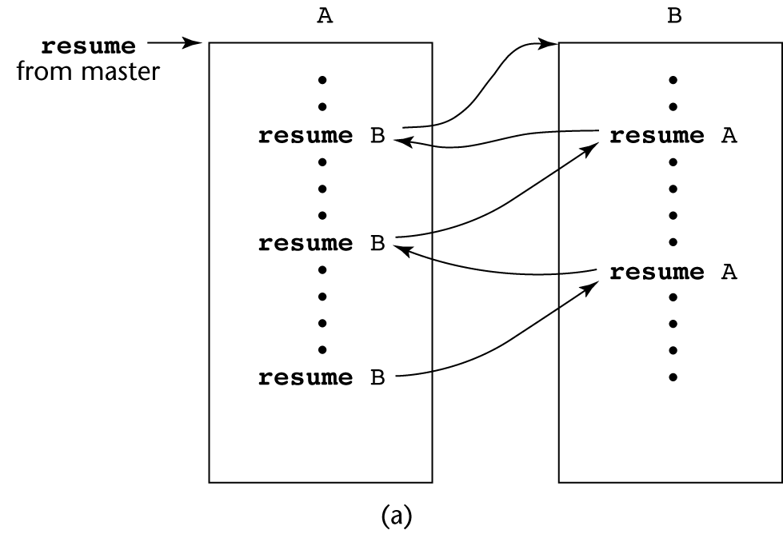
COROUTINES ILLUSTRATED: POSSIBLE EXECUTION CONTROLS
1-<number>

Slide 41
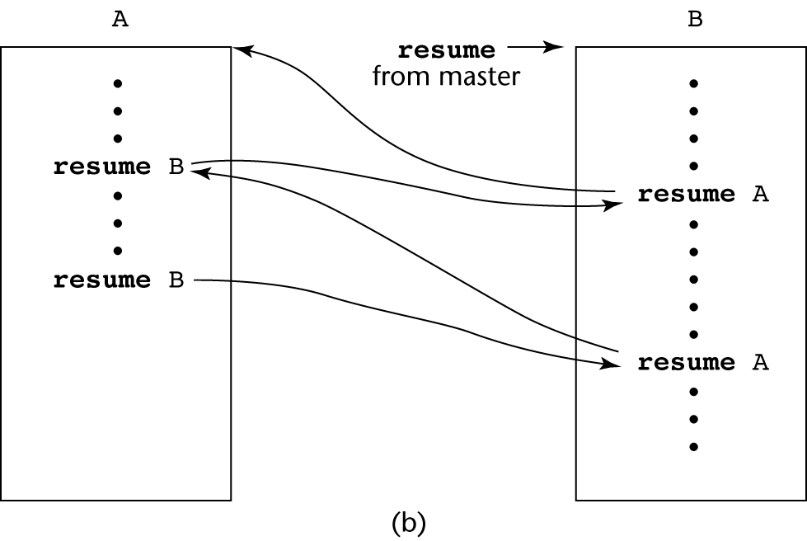
COROUTINES ILLUSTRATED: POSSIBLE EXECUTION CONTROLS
1-<number>

Slide 42
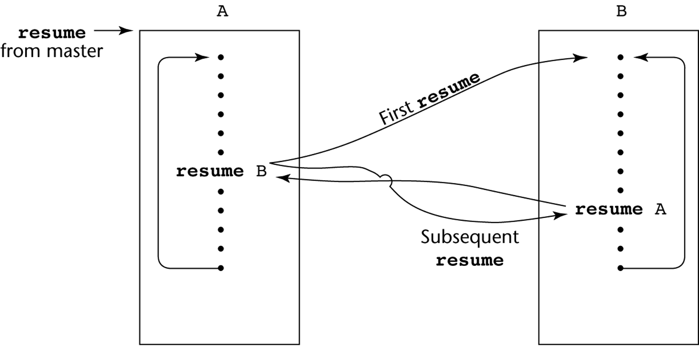
COROUTINES ILLUSTRATED: POSSIBLE EXECUTION CONTROLS WITH LOOPS
1-<number>

Slide 43
SUMMARY
A subprogram definition describes the actions represented by the subprogram
Subprograms can be either functions or procedures
Local variables in subprograms can be stack-dynamic or static
Three models of parameter passing: in mode, out mode, and inout mode
Some languages allow operator overloading
Subprograms can be generic
A coroutine is a special subprogram with multiple entries
1-<number>

